Slide 1
Regression Models
Lecture 5

Slide 2

Friday, August 23rd
National Find Your Inner Nerd Day
National Cuban Sandwich Day
National Sponge Cake Day

Slide 3
Resources Used for this Lecture
Scikit learn documentation: https://scikit-learn.org/stable/modules/generated/sklearn.linear_model.LinearRegression.html
University of Colorado Boulder's most excellent linear regression notes: https://www.colorado.edu/amath/sites/default/files/attached-files/ch12_0.pdf

Slide 4
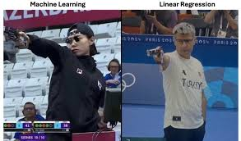
Linear Regression
Basic, but...
Sometimes the best tool for the job!
https://m.facebook.com/photo.php?fbid=3355554037911245&vanity=murad.alishah.52&slug=-fancy-big-models-vs-well-thought-out-project-planningi-love-this-meme-in-case-y

Slide 5
What is a linear regression?
Uses an independent variable (x)
To predict a dependent variable (y)
Y variable has a relationship with x variable such that y can be predicted if we know x

Slide 6
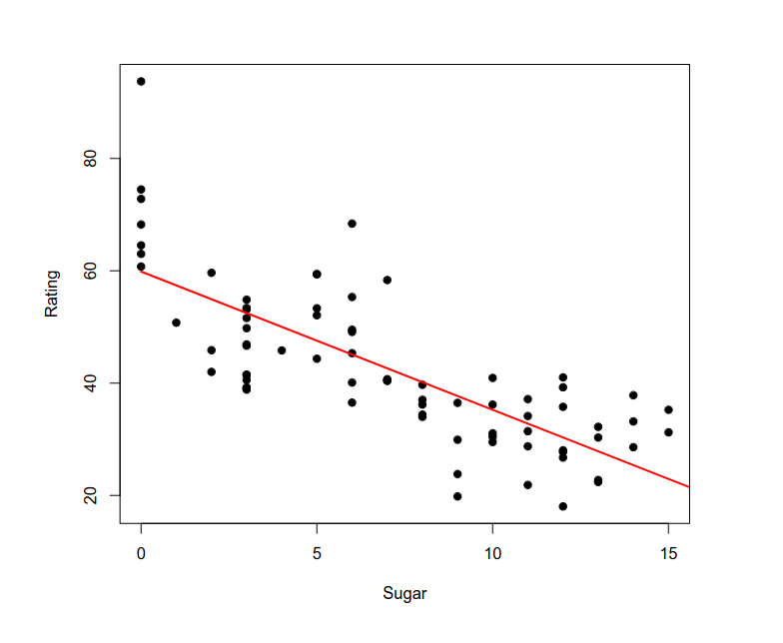
https://www.colorado.edu/amath/sites/default/files/attached-files/ch12_0.pdf

Slide 7
Linear Regression
y = dependent variable
x = independent variable (variable we have)
m = coefficient (slope)
b = constant added to the result
y = mx + b

Slide 8

For Example
Want to predict humidity given the temperature
Independent variable, x, is temperature
Dependent variable, y, is humidity
To get the humidity (y) for given temperature (x), multiply temperature by m and add b.
For example, if m = 0.5, and b = 10
If we have temperature of 54 degrees
Humidity = 54*0.5 + 10
Humidity = 37%

Slide 9
Let's Plot – Wine Example

Slide 10
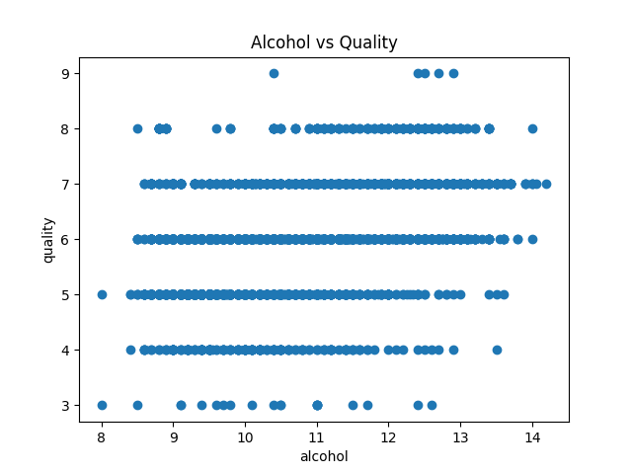
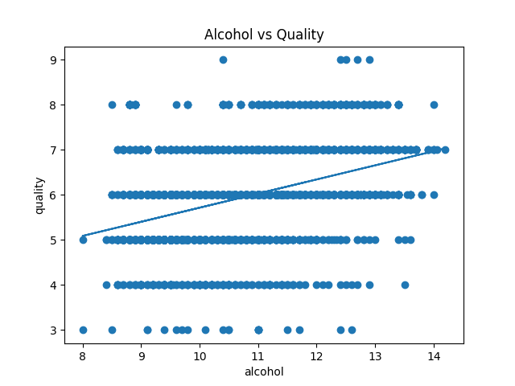
Let's Plot

Slide 11
What is a Line of Best Fit?
In a perfect regression model, every point in the dataset would exist along the line
So, y = mx+b for every x in the data.
In the real world, this doesn't happen
Real values, going to be slightly -- or greatly -- different from the predicted values
We want them to be as close as possible
One of the ways we can tell how well our line fits the model is by looking at the distance between predicted value and actual value

Slide 12
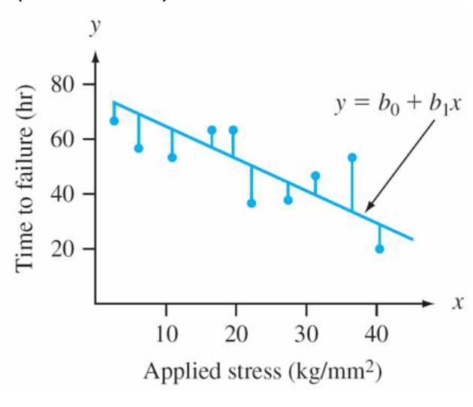
https://www.colorado.edu/amath/sites/default/files/attached-files/ch12_0.pdf

Slide 13
Evaluating the Line of Best Fit
We want distance between the real value and predicted value to be as small as possible for ALL points
Remember, though – differences can be positive or negative
So just adding the distances together might cancel them out – which would misrepresent the total error of the model
So let's square the errors first, before summing them
That gets us to the 'residual sum of squares', out total error term for the model

Slide 14
Model Error
We now have our error term, and we want a more accurate model, so we want to minimize the error to the smallest possible value
Goal now clear: find coefficient m and constant b so that our residual sum of squares is smallest value it can possibly be

Slide 15
Let's go back to basics!
Dataset
Type of Machine Learning
Data Split
Model Evaluation

Slide 16
Let's go back to basics!
Dataset
  Wine Quality. Input chemical characteristics (features), output wine quality score (outcome)
Type of Machine Learning
Data Split
Model Evaluation

Slide 17
Let's go back to basics!
Dataset
  Wine Quality. Input chemical characteristics (features), output wine quality score (outcome)
Type of Machine Learning
  Supervised
Data Split
Model Evaluation

Slide 18
Let's go back to basics!
Dataset
  Wine Quality. Input chemical characteristics (features), output wine quality score (outcome)
Type of Machine Learning
  Supervised
Data Split
  Do we need training or test here? Can explore
Model Evaluation

Slide 19
Let's go back to basics!
Dataset
  Wine Quality. Input chemical characteristics (features), output wine quality score (outcome)
Type of Machine Learning
  Supervised
Data Split
  Do we need training or test here? Can explore
Model Evaluation
  Residual Sum of Squares
  Coefficient of determination (we'll look at later)

Slide 20
What Next?
We need to take our data,
Create a model y=mx+b where we set m and b
Find a model that minimizes the residual sum of sqaures
How do we do this?

Slide 21
Ordinary Least Squares Regression
Is the method that a linear regression uses
I will link the notes that go into the math in more detail: https://www.colorado.edu/amath/sites/default/files/attached-files/ch12_0.pdf
Basically, you get the sum of squared residual functions in terms of and b and set equal to zero to minimize
Then take partial derivatives with respect to m and b to get the values
I'm just going to reproduce the essential formulas for m and b

Slide 22
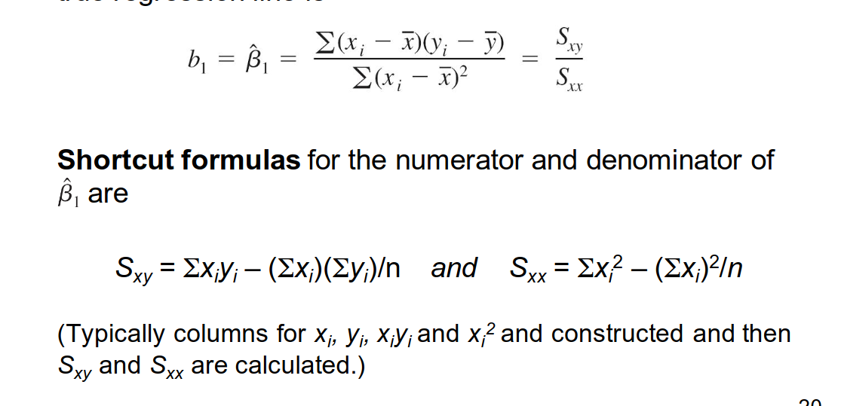
Equations
https://www.colorado.edu/amath/sites/default/files/attached-files/ch12_0.pdf

Slide 23
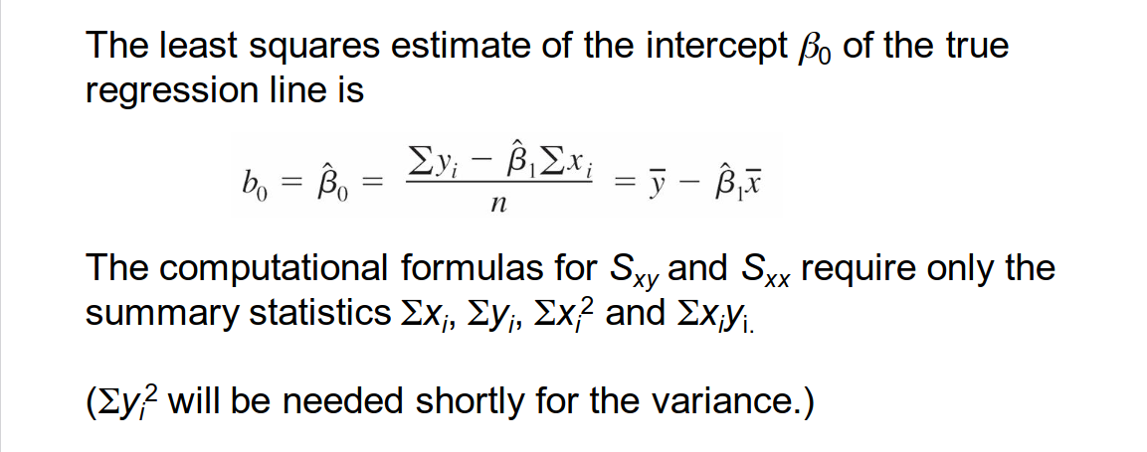
Equations
https://www.colorado.edu/amath/sites/default/files/attached-files/ch12_0.pdf

Slide 24
Model Evaluation
We could look at the residual sum of squares, we could also look at variance
How much of variance is explained by the model – does the model really explain what we are seeing?
We use something called Coefficient of Determination, or more commonly, R²
Residual sum of squares / total sum of squares

Slide 25
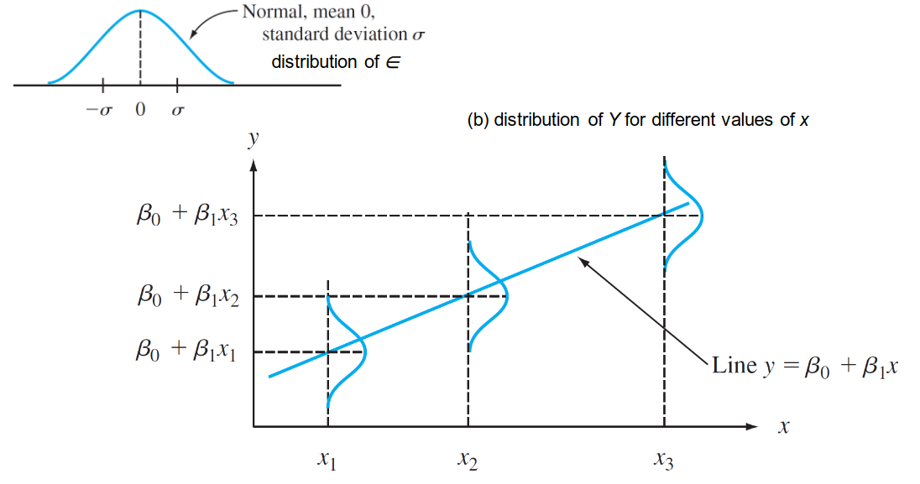
https://www.colorado.edu/amath/sites/default/files/attached-files/ch12_0.pdf

Slide 26
R²
Residual sum of squares = difference measurement between predictions and actual values
Total sum of squares - difference between samples and sample mean
Taking predictor measurement as proportion of sample mean difference measurement, get an idea of how much variance is explained by the model
Ideally – you want a high R² values - high performing model should explain a decent percent of variation in the data
  But you should be suspicious of a perfect score

Slide 27
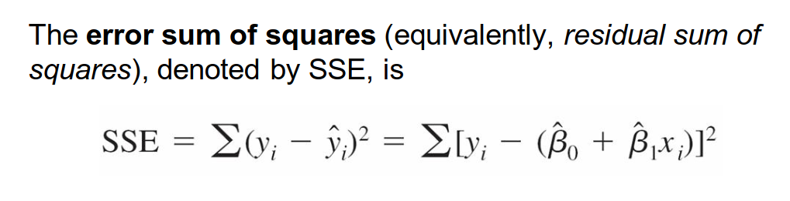
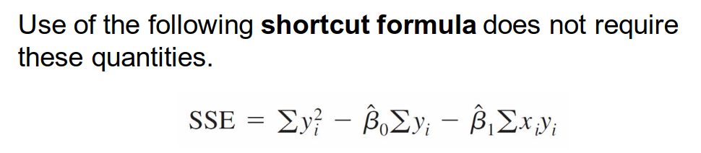
Equations
https://www.colorado.edu/amath/sites/default/files/attached-files/ch12_0.pdf

Slide 28
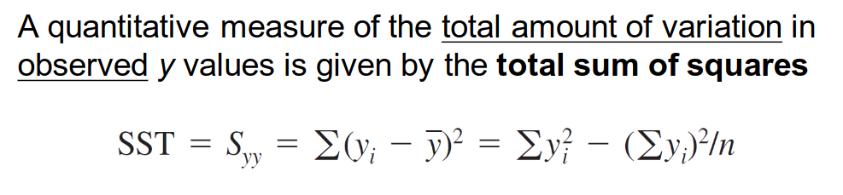
Equations
https://www.colorado.edu/amath/sites/default/files/attached-files/ch12_0.pdf

Slide 29
Let's implement this already!
On to code!

Slide 30
When is Linear Regression Good?
When your data looks pretty much linear
When variables are independent of one another and not colinear
When you need a simple, explainable model
When you are data constrained

Slide 31
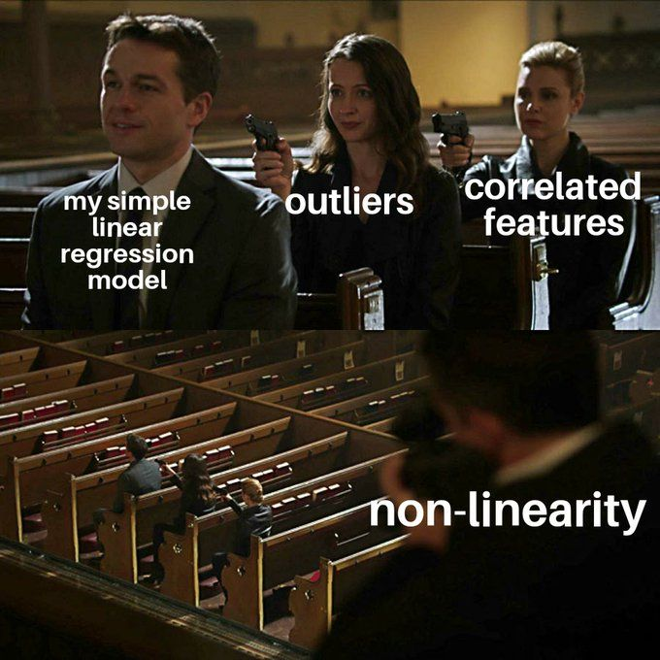
Drawbacks
Non-linear data
Very simple model – probably not the most accurate
Some people don't consider it a "real" machine learning technique
https://www.kaggle.com/discussions/general/431681

Slide 32
Other Regression Models
Source: https://www.appier.com/en/blog/5-types-of-regression-analysis-and-when-to-use-them
Multiple Linear Regression
Logistic Regression
Ridge Regression
Lasso Regression
Polynomial Regression

Slide 33
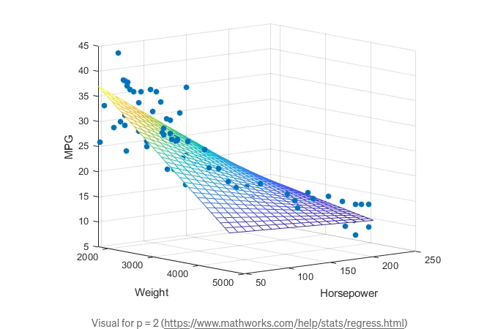
Multiple Linear Regression
Same as normal, but with more x variables
https://towardsdatascience.com/graphs-and-ml-multiple-linear-regression-c6920a1f2e70

Slide 34
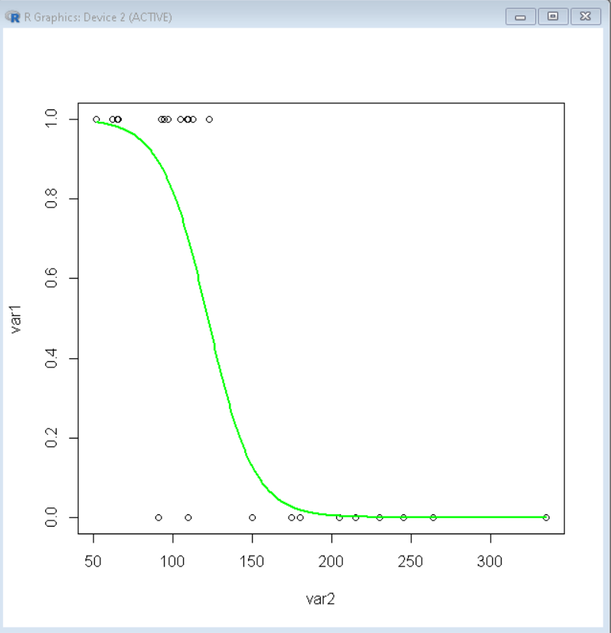
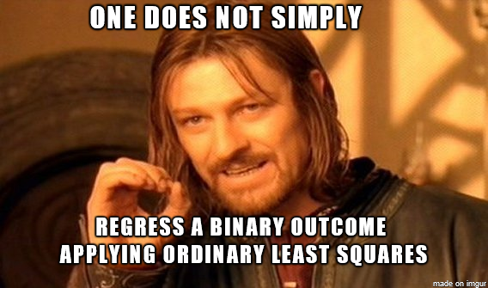
Logistic Regression
Uses Sigmoid Curve
Binary values
Source: Large datasets with almost equal value occurrence
https://imgur.com/gallery/logistic-regression-GOhfk6k
https://www.geeksforgeeks.org/how-to-plot-a-logistic-regression-curve-in-r/

Slide 35
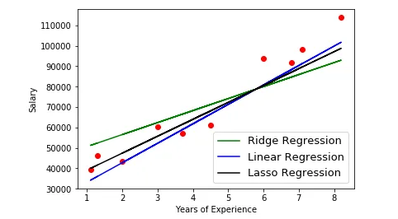
Ridge and Lasso Regression
Use regularization techniques to reduce model overfitting
Source: Good when independent variables highly correlated
https://medium.com/@mubarakb/ridge-and-lasso-a-simple-overview-6c3cc72fe7d

Slide 36
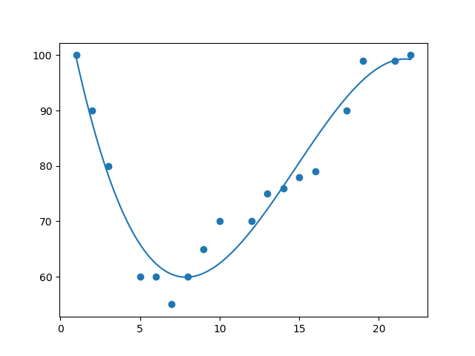
Polynomial Regression
Uses polynomial line to fit data
Source: prone to overfitting
https://www.w3schools.com/python/python_ml_polynomial_regression.asp

Slide 37
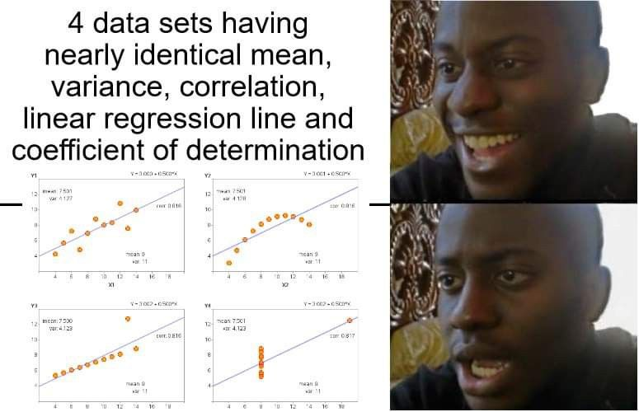
Questions?
https://in.pinterest.com/pin/academic-memes-xd--729935052119746525/

